Slide 1

Mapping and Spatial Analysis with ArcGIS and GeoDa
Project Mosaic Workshop
Date Feb 28th 2017
Paul H. Jung, Behnam Nikparvar
pjung1@uncc.edu, bnikparv@uncc.edu

Slide 2

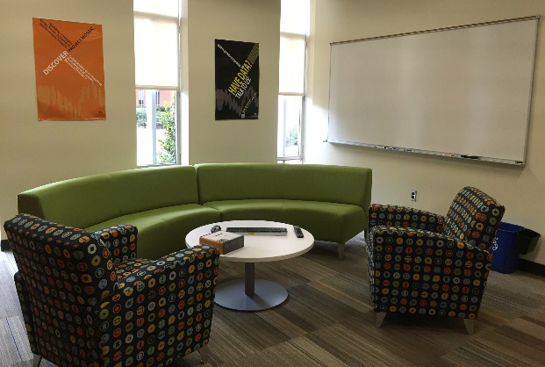
Project Mosaic
Project Mosaic: What do we do?
Build and enhance research analytics capability in social sciences
Facilitate research across social sciences
Coordinate and incubate social science research strategically
Project Mosaic Services
Social sciences research incubator
Facilitate connections
Bring people together to exchange ideas and pursue external funding
Information sharing on research funding opportunities
Consulting
Free to UNC Charlotte faculty, staff and graduate students
Workshops
Open to entire campus community
Provides cutting-edge tools for research and a forum for researchers to network within campus

Slide 3
Mapping and Spatial Analysis
Session I – Mapping and Spatial Analysis with ArcGIS
Introduction to Spatial Analysis
Interface of ArcGIS
Exercise with Real Data: Segregation in Charlotte
Mapping and Visualization
Session II – Mapping and Spatial Analysis with ArcGIS
Spatial Autocorrelation: Moran’s I Statistics
Hot-Spot Analysis: LISA
Introduction to GeoDa

Slide 4
Exercise with Real Data
Task 1: Types of communities in Charlotte Area
Mecklenburg County economic development office
Doing outreach and fund raising > high income communities
Development efforts > low income communities
Data type: polygon features (blockgroups)
Research questions
How is each income group distributed in Charlotte area?
Can we detect High/low income region in Charlotte?
How severe is the segregation problem in Charlotte?

Slide 5
Exercise with Real Data
Task 2: Cluster analysis of crash incidents in Washington DC
Department of transportation in Washington DC
Is there any clusters in crash incidents in DC
They want to know regions with high/low reports of crashes
We have point data with no attribute
Research questions
Is there clusters of crashes in DC?
Can we detect region with high/low crash level?

Slide 6
Exercise with Real Data
Moran’s I : Spatial Autocorrelation
LISA: Local Indicator of Spatial Association

Slide 7
Spatial Autocorrelation
Charlotte Area is much segregated by income. How much?
i.e., Are blocks with high median income near to other blocks with high high median income?
To investigate this, we use Moran’s I Statistics.

Slide 8
Spatial Autocorrelation
Spatial Autocorrelation
Tobler’s 1st Law of Geography: “Everything is related to everything else, but near things are more related than distance things”
Based on the fact that data from locations near one another in space are more likely to be similar than data from locations further from one another.

Slide 9
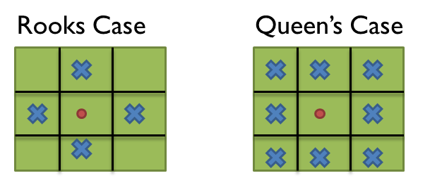
Spatial Autocorrelation
Defining Neighborhoods
1) Contiguity (polygons share a common boundary)
2) Distance-based measures
3) K-nearest neighbors
4) Distance Threshold
5) Other measures
Travel time
Social network distance

Slide 10
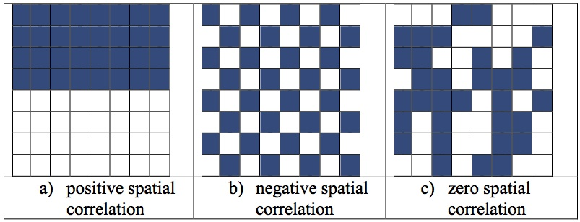
Spatial Autocorrelation
Moran’s I Statistics
Null Hypothesis H0: Not significant pattern (spatial randomness)
If I is close to “1” : Positive spatial autocorrelation
if I is close to “-1”: Negative spatial autocorrelation

Slide 11
Spatial Data
Execute “ArcMap”
Add Data: “McklnbrgCnty_BlckGrps.shp” (Census Block Map, 2010)

Slide 12
Joining Census Data
Join Spatial Data + Census Data
We should match spatial data with census data by “census block number”
Right-click “McklnbrgCnty_BlckGrps.shp” -> Joins and Relates -> Join

Slide 13
Spatial Autocorrelation
Open ArcToolbox
“Spatial Statistics Tools” -> “Analyzing Patterns” -> Spatial Autocorrelation
Input Feature Class: “McklnbrgCnty_BlckGrps.shp”
Input Field: variable you want
Conceptualization of Spatial Relationships: How is contiguity defined?
Standardization: Controlling the number of neighborhoods

Slide 14
Hot Spot – Cold Spot Detection
Detecting Spatial Clusters of Income Groups
Okay, we could see there is strong spatial autocorrelation, but where?
Where does high income people live much near to high income area?
income cluster

Slide 15
Hot Spot – Cold Spot Detection
Anselin Local Moran’s I
Moran’s I Statistics only detects global spatial association
Local Indicator of Spatial Association (LISA) such as Anselin Local Moran’s I can detect clusters.

Slide 16
Hot Spot – Cold Spot Detection
Open ArcToolbox
“Spatial Statistics Tools” -> “Mapping Clusters” -> Cluster and Outlier Analysis
Input Feature Class: “McklnbrgCnty_BlckGrps.shp”
Input Field: variable you want
Conceptualization of Spatial Relationships: How is contiguity defined?
Standardization: Controlling the number of neighborhoods

Slide 17
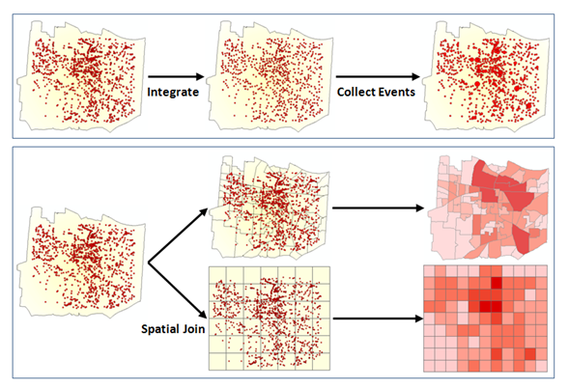
Spatial Autocorrelation
Sometimes we have incidents data. Like crashes or disease occurrence
This means we have no specific attributes
The hot spot analysis still needs to have attribute values which are associated with features
http://pro.arcgis.com/en/pro-app/tool-reference/spatial-statistics/h-how-hot-spot-analysis-getis-ord-gi-spatial-stati.htm

Slide 18
Spatial Autocorrelation
Add “accdnt_2016_1.shp” and “blckgrps.shp”
Right Click on “blckgrps.shp” > join > Spatial join
Open ArcToolbox
“Spatial Statistics Tools” -> “Analyzing Patterns” -> Spatial Autocorrelation
Input Feature Class: “blckgrps.shp”
Input Field: variable you want
Conceptualization of Spatial Relationships: How is contiguity defined?
Standardization: Controlling the number of neighborhoods
Now we can also find hot/cold spots

Slide 19
GeoDa

Slide 20
More About Services
Research Incubator
Affiliates Program
Faculty Affiliates are invited for their research expertise in priority research areas
Our affiliates leverage the core functionality and expertise of Project Mosaic
Seed Grants Program
Geared towards the formation of new teams of researchers in the social, behavioral and economic sciences
Aim is to pursue external funding
Consulting
Project Mosaic offers three types of consulting:
Software-centric
Dissertation/thesis assistance
Research deign & collaboration
Workshops
Our workshops fulfill a commitment to enhance data literacy and analytical capabilities of UNC Charlotte researchers
Make an appointment on our website!
Find workshops online on our Events List.

Slide 21



Contact Project Mosaic
Jean-Claude Thill is the director of Project Mosaic. A broadly trained geographer, he is a ‘Knight’ Distinguished Professor of Public Policy at UNC Charlotte.
Contact Jean-Claude:
Email: Jean-Claude.Thill@uncc.edu
Phone: 704-687-5909
Leonora is the Administrative Support for Project Mosaic. She manages our not-so-massive paperwork, coordinates meetings and assists with administrative functions.
Contact Leonora:
Email: projectmosaic@uncc.edu
Phone: 704-687-5931
Visit our website!
Projectmosaic.uncc.edu

Slide 22


Additional Resources: Consultants
Shaoyu Li is the head consultant in the Center of Statistics and Applied Mathematics Consulting Center (CSAMC) and works with Project Mosaic to coordinate consulting requests for data sampling designs and statistical analysis.
Contact Shaoyu:
Email: shaoyu.li@uncc.edu
Kailas Venkitasubramanian is a research methodologist and manages the consulting service and the workshop program of Project Mosaic. Kailas is experienced in a variety of applied statistical techniques and works fluently on multiple software platforms.
Contact Kailas:
Email: kvenkita@uncc.edu
Notes:
https://projectmosaic.uncc.edu/make-a-consulting-appointment/

Slide 23
Questions?

